Slide 1
Adaptive Crowdsourcing via EM with Prior
Peter Maginnis
Tanmay Gupta

Slide 2
Main Contributions
Derivation of EM with transformed beta prior
Adaptive graph construction
Random Forest Ranking
Features:
Task entropy
Histogram of worker abilities
Number of workers per task

Slide 3
Expectation-Maximization
Tasks
Workers

Slide 4
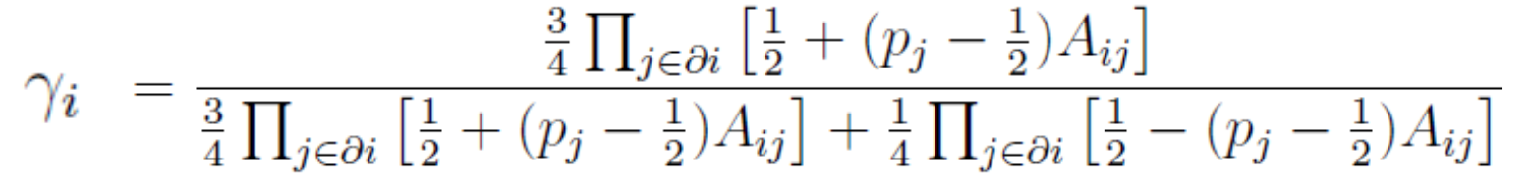
EM without beta prior
E Step:

Slide 5
EM without beta prior
M Step:

Slide 6
EM with Prior

Slide 7
Initial Graph
Current Graph
EM
Generate Random Data
Prior
Graph Update
EM
RF Ranking
Learn RF

Slide 8
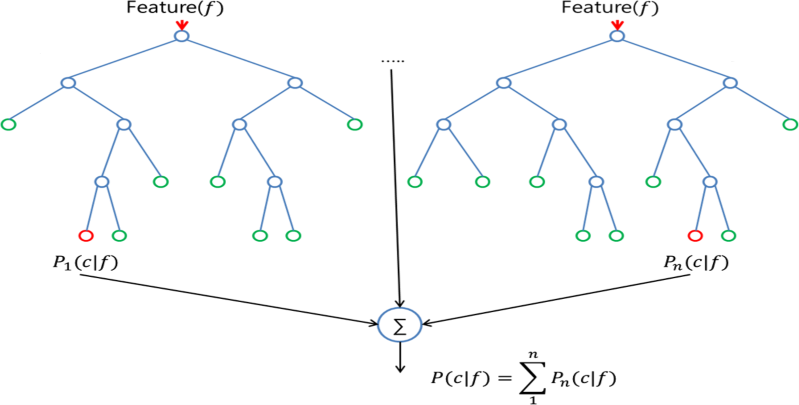
Random Forest
Tree 1
Tree n

